Slide 2
Literary Fiction Writing for Secondary School Students
Jenny Baker
Jenny.baker@freospeech.com.au

Slide 3
Genres
Romance | Action Adventure | Science Fiction
Suspense Thriller | Young Adult | Horror
Mystery | Crime | Historical
Western | Family Saga | Literary Fiction

Slide 4
Examples of Literary Fiction
The Catcher in the Rye
Of Mice and Men
To Kill a Mockingbird
Jasper Jones
Where the Crawdads Sing
The KiteRrunner
Life of Pi

Slide 5
Literary Fiction
No need for a dynamic plot
Third person
High emotion and imagery
Marginalised character
Must develop or change over the course of the story
Ordinary → extraordinary
Read examples (Only Ten by Allan Baillie)

Slide 6
Simple Steps
Construct a character: name / appearance / behaviour / back story /
Construct a setting
Determine something to foster change
Notes:
Badi followed his uncle as he pushed his way through the crowded Melbourne markets. He could smell the stench of decaying fish and old piles of rotting fruit. Badi could hear the conversations of customers as they try to get a bargain for their fruit and the venders trying to persuade people to buy their plump rich mangoes. “Two mangoes for $5”. The air had a freezing chill on it. The rain thumped down onto the old rusty roof. The wind howled through gapes in the walls making little tornadoes. The wind sent chills down his spine. There were puddles every from the holes in the rusted tin sheeting.
Badi felt out of place as everyone had coats and long warm trousers while he was dressed in thin and tattered clothes that his uncle had lent him. There was no colour amongst the chaos. Except for one stall. The vibrant colours of the fruit drew Badi towards the …Stall…… like a bee to honey. As he got closer, he could smell the sweet fragrant aroma of the delicious fruit. There were towers of shiny red apples, stacks of perfect fresh strawberries and mountains of golden ripe mangoes. In the midst of a wintery day, a ray of sunshine broke through the gloomy market place. The sunshine settled upon a luscious rosy peach. As if it was a gift from heaven. Badi dreamt of biting into the irresistible peach, and for a few seconds, he was lost in his imagination. Badi felt his pockets for some coins to buy the prize peach, but of course there were none. Badi secretly looked around and noticed everyone was busy buying, selling and chatting. The temptation was too much. Swiftly and carefully he swept the precious peach away and slipped it under his scruffy shirt. There was an immense surge of joy throughout Badi’s body.
Badi rubbed his fingers along the outline of the plump peach. The texture was fury and soft and reminded him of the old peach tree in his grandmother’s backyard back home in ?Afghanistan?. Badi caught up to his uncle who was buying the ‘black sheep’ of the food. He could feel the urge to take a nibble of the gorgeous peach but had to use all of his will power to resist the temptation.
The wait for the tram to take Badi and his uncle home to Ringwood seemed to take forever even through it was only a few minutes. Once on the crowded tram, people were pushing and shoving for a seat. The noisy school kids dominated the back of the tram. When uncle found a seat Badi stood shyly nearby, wondering when he would be able to taste the precious peach that he was holding gently under his shirt. Suddenly the school kids got off making room for Badi at the back of the tram. Badi stealthily slid towards the back and found a seat in the corner. He took out the peach, just steering at its beauty in owe. As Badi bit into the succulent peach, memories of his childhood flooded back. Images of Badi and his siblings climbing his grandmothers old peach tree overwhelmed him. He could almost feel himself stretching as he reached for the glorious peaches that hung there on the highest branches. The sweet smell, the intense taste and the soft texture of the peach reminded him of the happiest time of his life. And the most precious memory was of his grandmother sitting under the shade of the peach tree humming their favourite songs.

Slide 7
Constructing a Character

Slide 9
Goals and Motivations
Clearly define the main character's goals and motivations. What do they want to achieve, and why is it essential to them? This will give the character purpose and drive the story forward.

Slide 10
Conflict and Obstacles
Introduce challenges and obstacles that the main character must overcome. This conflict creates tension and keeps readers engaged in the story.

Slide 11
Personality and Traits
Develop a well-rounded personality for the main character. Consider their strengths, weaknesses, fears, and quirks. A complex character feels more real and relatable to readers.

Slide 12
Backstory
Provide some backstory to the main character that explains their past experiences and how they became who they are at the start of the story. However, avoid excessive exposition and only include relevant details.

Slide 13
Growth and Development
Allow the main character to experience growth and development throughout the story. As they face challenges and overcome obstacles, they should change in some way, whether it's a shift in beliefs, values, or behaviour.

Slide 14
Relatability
Make the main character relatable to readers. Even if their circumstances are different, readers should be able to connect with their emotions and struggles on a human level.

Slide 15
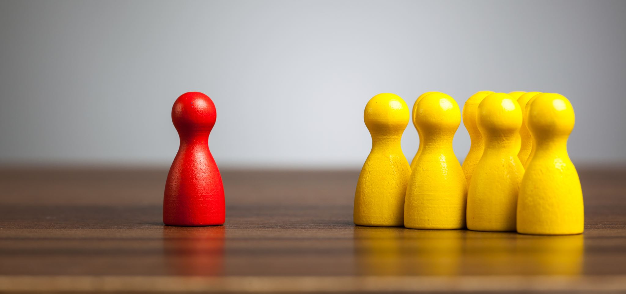
Internal Conflict
Explore the main character's internal conflicts and emotions. This adds depth to the character and allows readers to empathize with their struggles.

Slide 16
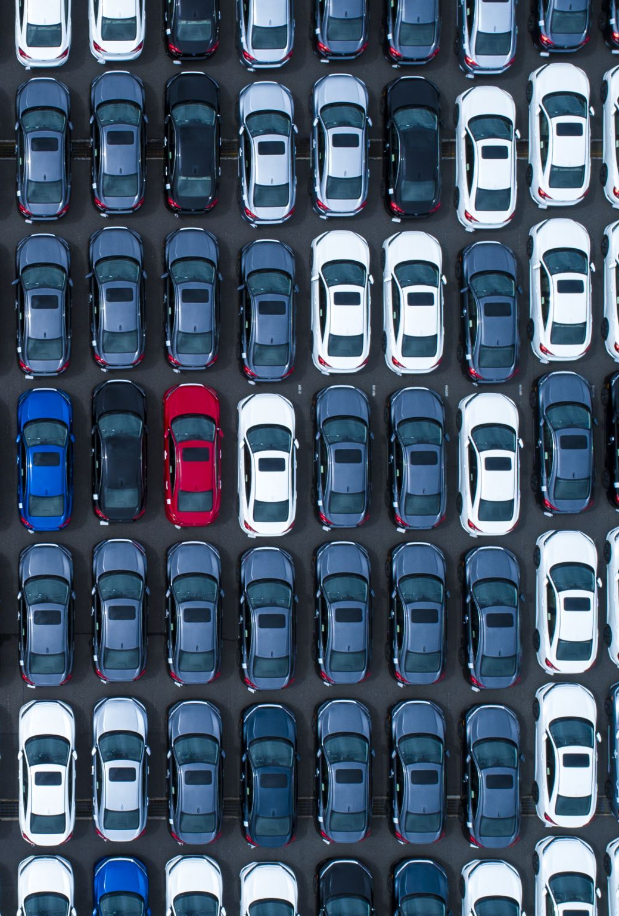
Agency
Ensure the main character has agency and actively contributes to the story's progression. They should be the driving force behind their own decisions and actions.

Slide 17
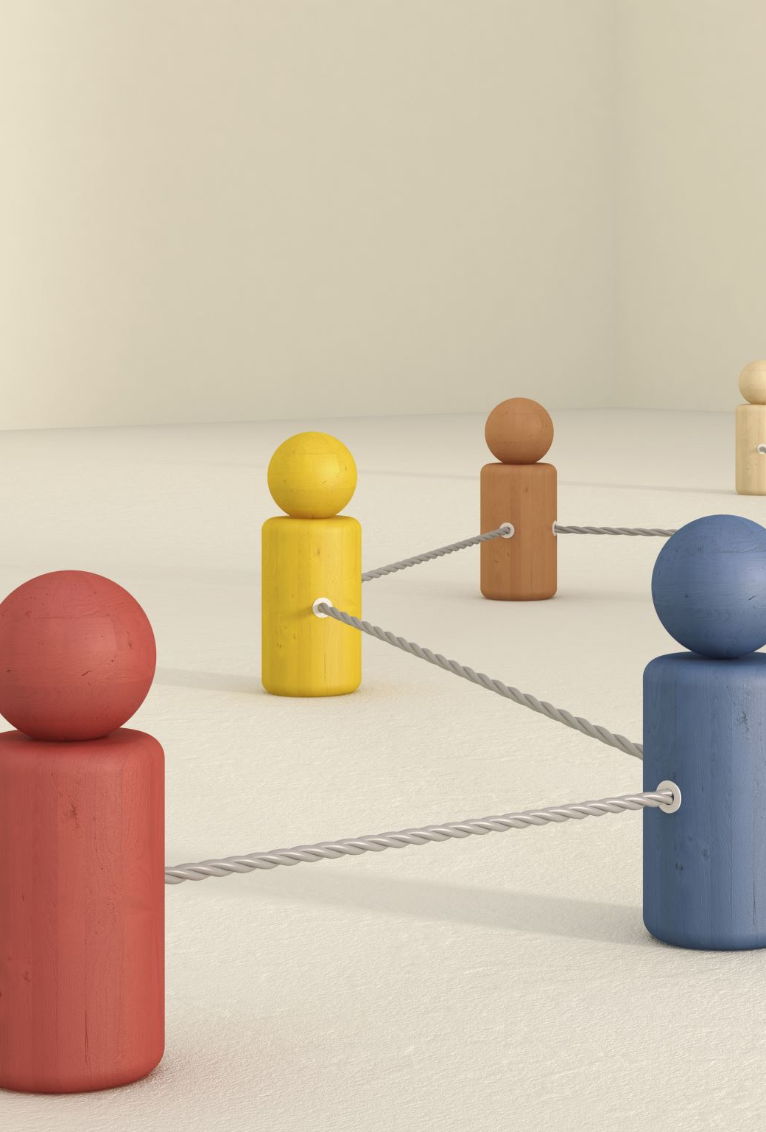
Relationships
Develop meaningful relationships between the main character and other characters in the story. How they interact with others can reveal aspects of their personality and add emotional depth.

Slide 18
Setting and Worldview
Consider how the main character's background and experiences influence their worldview. How do they perceive the world around them, and how does it shape their actions?

Slide 19
Unique Voice
Give the main character a distinctive voice and manner of speaking. This helps to differentiate them from other characters and makes them memorable.

Slide 20
Limitations
Establish limitations for the main character to make them more realistic and relatable. Nobody is perfect, and flaws can make a character more compelling.

Slide 21
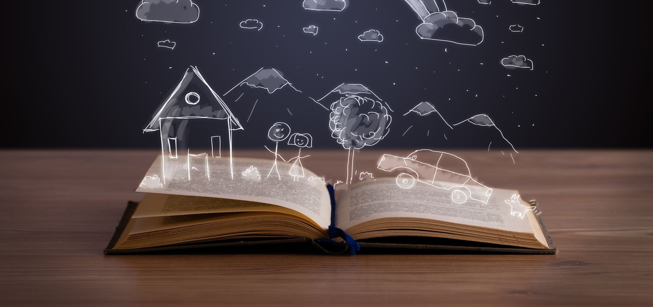
Resolution
Plan how the main character's journey will conclude. What lessons will they learn, and how will they change by the end of the story?

Slide 22
A well-developed main character is the heart of a compelling short story. By giving them depth, complexity, and relatability, you can draw readers into their world and create a memorable narrative experience.

Slide 23
Use images and videos to develop the character

Slide 24
Use videos and images to develop the setting for the back-story

Slide 25
Design Your Character

Slide 26
Name
Gender
Age
Country of Origin
Personality
Physical Appearance
Clothing
Language
Back Story

Slide 27
Plot Schemas

Slide 28
Types of Conflict
1. Person against person
2. Person against nature
3. Person against self
4. Person against society
5. Person against the supernatural
6. Person against technology

Slide 29
Ideas
Backstory | Conflict | Catalyst for Change
Brother dies under his watch | Internal – terrible guilt | Soccer game Forgets guilt for a short moment
Leaves Afghanistan to live in Australia | With others (bullied) | Connects with bully over both experiencing fathers’ deaths (similar to Only Ten)
Leaves Afghanistan to live in Australia | Internal – misses his family and culture | Eats a mango and is transported to his homeland
Leaves Afghanistan to live in Australia | With others (bullied) | Soccer game Wins and is accepted

Slide 30
Person against self

Slide 31
Person against person

Slide 32
Person against society

Slide 33
Write your own version of the story and unpack it

Slide 34
Plan for Story 1

Slide 35
Young boy
Name is Badhi
Kids tease him and call him baddy
12
Small / rough hair / dark deep set eyes / thin
Scars on his back
Always looks worried and scared as if something bad is about to happen
Shy
Doesn’t talk
Doesn't trust people in general
Never smiles
Jumpy and on edge
Afghanistan
Parents dead
Uncle survived bombings
Brought to Australia
Family home filled with happy memories of family and life
Destroyed in war

Slide 36
Lives in an old house in state housing complex
Lives with uncle
Rough area
Bland streets no trees
Remembers his house as being filled with love and joy
Internal conflict
Feels like he has betrayed his family and country by coming to Australia
Feels guilty for not being able to prevent his parents from dying
Believes his parents may even still be alive and he resents his uncle for taking him away from his village / community
Finds something or makes something or meets someone or does something that comforts him and makes
him come to the realisation that his parents are dead and that he must forge a new life in this country
Re-bonds with his uncle
Meets and comforts someone who has had a similar experience to him
Someone he can relate to
Things change for the better

Slide 37
Plan for Story 2

Slide 38
Set the scene of the Fremantle markets
Jacob walked behind his Grandfather through the market stalls in Fremantle
Loud
See and smell the laughter
Surrounding conversations
People bargaining for their vegetables
Vendors advertising their wares “two for $3”
Air warm and slightly uncomfortable
He felt trapped in his oversized cheap woolen jumper and track suit pants
All his grandfather could afford at the Salvos

Slide 39
Holding GF’s hand
Sees fruit
One vendor
Bright shiny bunches of golden grapes
Multilayered rows of nourishing red apples that have been carefully selected and arranged
like miniature soldiers standing to attention
Pyramids of luxurious oranges waiting for their turn to be plucked from the pile
Shaft of piercing light from a small crack in the roof shone down on one single plump beautiful mango
As sweet as Summer showers
As if it was a fallen miracle

Slide 40
Eyes fell upon the mango
Couldn’t afford it
Wanted it so badly
he steals it from the display and puts it in his jumper
Walking through the markets
Watching his Grandfather as he buys…..
Whole time he feels intoxicated by the presence of the mango
explain a bit more about his feelings
On the bus back to GF’s home in Beaconsfield
Jacob looks out the window
Begins to eat the mango
Describe the experience of eating
Drips
Pulp on face
Sweetness

Slide 41
Transports him back to Africa
To happier times
Describe what he thinks about as he devours the mango
Family
Gentle sun on his face
Running through fields
Expressions of laughter and banter
Free and open
Sense of clean open air
Untouched by chemicals
Sense of being home
Slips large wet juicy pip in pocket
Connection to home

Slide 42
Badi followed his uncle as he pushed his way through the crowded Melbourne markets. He could smell the stench of decaying fish and old piles of rotting fruit. Badi could hear the conversations of customers as they try to get a bargain for their fruit and the venders trying to persuade people to buy their plump rich mangoes. “Two mangoes for $5”. The air had a freezing chill on it. The rain thumped down onto the old rusty roof. The wind howled through gapes in the walls making little tornadoes. The wind sent chills down his spine. There were puddles every from the holes in the rusted tin sheeting.

Slide 43
Badi felt out of place as everyone had coats and long warm trousers while he was dressed in thin and tattered clothes that his uncle had lent him. There was no colour amongst the chaos. Except for one stall. The vibrant colours of the fruit drew Badi towards the …Stall…… like a bee to honey. As he got closer, he could smell the sweet fragrant aroma of the delicious fruit. There were towers of shiny red apples, stacks of perfect fresh strawberries and mountains of golden ripe mangoes. In the midst of a wintery day, a ray of sunshine broke through the gloomy market place. The sunshine settled upon a luscious rosy peach. As if it was a gift from heaven. Badi dreamt of biting into the irresistible peach, and for a few seconds, he was lost in his imagination. Badi felt his pockets for some coins to buy the prize peach, but of course there were none. Badi secretly looked around and noticed everyone was busy buying, selling and chatting. The temptation was too much. Swiftly and carefully he swept the precious peach away and slipped it under his scruffy shirt. There was an immense surge of joy throughout Badi’s body.

Slide 44
Badi rubbed his fingers along the outline of the plump peach. The texture was fury and soft and reminded him of the old peach tree in his grandmother’s backyard back home in ?Afghanistan?. Badi caught up to his uncle who was buying the ‘black sheep’ of the food. He could feel the urge to take a nibble of the gorgeous peach but had to use all of his will power to resist the temptation.
The wait for the tram to take Badi and his uncle home to Ringwood seemed to take forever even through it was only a few minutes. Once on the crowded tram, people were pushing and shoving for a seat. The noisy school kids dominated the back of the tram. When uncle found a seat Badi stood shyly nearby, wondering when he would be able to taste the precious peach that he was holding gently under his shirt. Suddenly the school kids got off making room for Badi at the back of the tram.

Slide 45
Badi stealthily slid towards the back and found a seat in the corner. He took out the peach, just steering at its beauty in owe. As Badi bit into the succulent peach, memories of his childhood flooded back. Images of Badi and his siblings climbing his grandmothers old peach tree overwhelmed him. He could almost feel himself stretching as he reached for the glorious peaches that hung there on the highest branches. The sweet smell, the intense taste and the soft texture of the peach reminded him of the happiest time of his life. And the most precious memory was of his grandmother sitting under the shade of the peach tree humming their favourite songs.

Slide 46
Formulas for Frames: Delivering the Program
A methodology for teaching students the how and why
of employing specific language devices within a narrative genre.

Slide 47
Read these two texts and identify differences between them.
Year 4 girl
“Average” writer as reported by teacher
3 minutes planning
30 minutes writing
First prompt: The night a girl/boy got locked inside Target
Second prompt: The day a lion escaped from the zoo

Slide 48
PRE-TEST April 2021
Title: The night a boy or girl got locked inside target.
It was the girl’s birthday, she got a $50 gift card for Target. It seemed like The Best birthday ever…
May openend her small gift and knew straight away it was the Target gift card she wanted. She was right, May screamed with delight “finally,” you got me one!”.
It was 5 o clock by that time May and her parents went to the shopping centre. ‘ok May you can go into target by yourself while we do some shopping” said May’s parents. so she ran right into the humongeos store. Then she heared the announcement: This store will close in 5 minutes,” May hurried to find this toy but it was to late the workers shut the doors and locked them. May was scared…
The end.
PRE-TEST April 2021
Title: The night a boy or girl got locked inside target.
It was the girl’s birthday, she got a $50 gift card for Target. It seemed like The Best birthday ever…
May openend her small gift and knew straight away it was the Target gift card she wanted. She was right, May screamed with delight “finally,” you got me one!”.
It was 5 o clock by that time May and her parents went to the shopping centre. ‘ok May you can go into target by yourself while we do some shopping” said May’s parents. so she ran right into the humongeos store. Then she heared the announcement: This store will close in 5 minutes,” May hurried to find this toy but it was to late the workers shut the doors and locked them. May was scared…
The end.

Slide 49
POST-TEST July 2021
Title: How my lion came to me.
Last week, my lion friend escaped from the zoo. He opened the iron gates (somehow?) and ran along the wet road to the staition. he was the only one on the train because the sky was as black as a beetle. He carryeid his breifcase off the rusty, metal step train to small shop, He sat down next to a lady but she just glared at my lion and scuttled away fastly. Next my lion hopped on an empty bus but he was to big. So he walked in the cold rain for miles until his legs were so tired they could drop off. He sat down gently on the narrow foot path and whined. The wind blew through his mane and he shivered. He knew he needed to find somewhere to sleep. He rubbed his hands together and stood up. He quickly ran along the soggy foot path and came to my narrow house. He knocked on the door, and mum opened it. Luckily mum let him in. Now he lives with me. FOREVER.

Slide 53
What was taught between April and July….?
The Narrative Hill (for macrostructure)
Language Devices according to their function – what “job” they do within the sentence.
Construction of well-formed sentences via a Tier 1 program delivered over 8 weeks for one hour a week

Slide 55
1. Dynamic Action
1. Upgraded verbs (ran → sprinted)
2. Adverbs of manner (….ly words such as quickly)

Slide 56
2. Reflection + Planning
Mental verbs
cognitive (he decided to…)
emotional (he hated….)
sensory verbs (he heard…)

Slide 57
3. Orientation
1. Adverbs of time (later that night,….)
2. Adverbs of place (in the corner of the room,…)

Slide 58
4. Specificity
Proper nouns (Perth Zoo)
2. Upgraded nouns (way → direction)
3. Appositives (Mrs Turner, the principal of Port City Primary School,…)
4. Adverbs of degree (entirely covered…)
5. Adverbs of frequency (never finished…)

Slide 59
5. Imagery
Adjectives: Pre modifying (the tiny black kitten…)
2. Adjectives: Post modifying (the kitten with long whiskers…)
3. Adjectives: Part of a subject (the kitten) + verb (is) + adjective (cute) construction
4. Similes / Metaphors
(Simile: the mast broke like a toothpick)
(Metaphor: the boy was a machine)
5. Idioms (couldn't believe his eyes)

Slide 60
Imagery continued
6. Personification through the choice of adjective (the angry waves) or through the choice of verb (the waves dominated the shore)
7. Onomatopoeia (the engine whirred)

Slide 61
6. Connectivity for Establishing…
Reason (using because, since, as…)
2. Consequence (using so, therefore, and as a result…)
3. Adversity (using but, however, although…)
4. Time (using before, after, during, until, as soon as, whenever…)
5. Condition (using if, on the condition that…)
6. Addition (and, and in addition…)

Slide 62
7. Emphasis
Repetition (he ran on and on and on)
2. Rule of threes (up the street, around the corner and over the hill)
3. Alliteration (the sneaky seagull…)
4. Rhetorical question (How will he get out now?)

Slide 63
8. Cohesion
Cohesive devices (J-Mart = the department store = the huge shop)
2. Correct pronominal referencing (using pronouns to represent characters)
3. Theme-related words (verbs and adjectives and nouns that ‘go together’ to develop a theme such as ‘war’)

Slide 64
Extract the “skill” from the “game” but put it back in the “game” when it is accomplished!

Slide 65
Teaching at Sentence Level
To teach written expression at the “Sentence Level”, we MUST have good “recipes” for sentences.
In order to construct effective sentences, we MUST select the very best “ingredients” for them.
Understanding grammar allows us to choose those “ingredients”.

Slide 66
Teaching the Macrostructure and Microstructure… one Sentence at a Time

Slide 67
Frame 1

Slide 68
Frame 1
Several months ago,
a family from Fremantle sailed their yacht across the Indian Ocean
for a grand adventure.
The sea was crystal clear,
and the sun shone brightly like a diamond.
Where in the Narrative Hill is this?

Slide 70
Several months ago,
a family from Fremantle sailed their yacht across the Indian Ocean for a grand adventure.
Adverbs of time (orientation)
Last year
Before Christmas
In the middle of June
Discuss the characteristics of ‘temporal” words

Slide 71
Several months ago,
a family from Fremantle sailed their yacht across the Indian Ocean for a grand adventure.
Proper Nouns (specificity)
Sydney Harbour
Bermuda Triangle
Discuss how you could use the name of the family to increase specificity

Slide 72
Several months ago,
a family from Fremantle sailed their yacht across the Indian Ocean for a grand adventure.
Adverb of Place (orientation)
around the world
through the Bahamas
Discuss prepositions and why only some work in this instance

Slide 73
Several months ago,
a family from Fremantle sailed their yacht across the Indian Ocean for a grand adventure.
Connection of Reason
because they wanted to go
as they wanted to go
since they wanted to go
Discuss connectors of reason and why only some work in this instance

Slide 74
Several months ago,
a family from Fremantle sailed their yacht across the Indian Ocean for a grand adventure.
Upgraded Words
went → sailed
boat → yacht
big → grand
holiday → adventure
Discuss how upgrading the verbs, adjectives and nouns increases specificity

Slide 75
The sea was crystal clear,
and the sun shone brightly like a diamond.
Imagery via adjectives
SVC sentence
2 adjectives
Emphasis via Alliteration
bright blue
wild and wavy
Discuss how you can do two jobs with the same words

Slide 76
The sea was crystal clear,
and the sun shone brightly like a diamond.
Connection of addition
“and” is used to connect two clauses
Discuss how some people overuse ‘and’

Slide 77
The sea was crystal clear,
and the sun shone brightly like a diamond.
Adverb of Manner
(dynamic action)
brilliantly
glowingly
radiantly
Discuss how adverbs of manner have __ly endings and can add to the verb or the adjective

Slide 78
The sea was crystal clear,
and the sun shone brightly like a diamond.
Simile (to create imagery)
disco ball
torch
high-beam light
Discuss how similes can make the reader associate two things.
Also, discuss the two formations of similes – as bright as a XXXX or like a XXXXX

Slide 79
Formula for sentence one:
Adverb of time +
Name of family (Proper noun) +
Origin of family + (Proper noun)
Upgraded verb +
Upgraded noun +
Adverb of place +
Proper nouns +
Connector of reason +
Upgraded adjective +
Upgraded noun

Slide 81
Write a sentence using the formula:

Slide 82
Formula for sentence two:
2 adjectives +
Alliteration +
Connection of addition +
Adverb of manner +
Simile

Slide 83
Write a sentence using the formula:

Slide 84
Frame 2
Without warning,they were confronted with a massive storm.
Lightning cracked above their heads,
and a huge angry wave snapped the mast in half like a toothpick.
Where in the Narrative Hill is this?

Slide 86
Frame 2

Slide 87
Frame 2
Without warning,they were confronted with a massive storm.
Adverb of time
(with dangerous connotations)
suddenly
all of a sudden
in a flash
immediately
Discuss how an adverb of time can have additional jobs in the sentence –
such as to create suspense or danger

Slide 88
Frame 2
Without warning,they were confronted with a massive storm.
Upgraded verb for ‘saw’
faced with
witnessed
noticed
Discuss how a verb can make such a difference to the “vibe” of the action

Slide 89
Frame 2
Lightning cracked above their heads,
and a huge angry wave snapped the mast in half like a toothpick.
Explore the verb ‘cracked’ (onomatopoeia)
Discuss how onomatopoeia can be used to create the imagery you desire in your writing

Slide 90
Frame 2
Lightning cracked above their heads,
and a huge angry wave snapped the mast in half like a toothpick.
Adverb of Place (Orientation)
in the sky
through the rain
all around them
Discuss prepositions and why only some work in this instance

Slide 91
Frame 2
Lightning cracked above their heads,
and a huge angry wave snapped the mast in half like a toothpick.
Connection of addition
“and” is used to connect two clauses
Discuss how some people overuse ‘and’

Slide 92
Frame 2
Lightning cracked above their heads,
and a huge angry wave snapped the mast in half like a toothpick.
Personification via the adjective
angry
vicious
violent
raging
fuming
Discuss how we can inject objects with ‘living’ qualities to
Help the reader imagine what they look like or behave like

Slide 93
Frame 2
Lightning cracked above their heads,
and a huge angry wave snapped the mast in half like a toothpick.
Upgraded verb (dynamic action)
splintered
shattered
wrenched
sliced
ripped
Discuss how good quality verbs can assist to emphasise the
characteristics of the action

Slide 94
Frame 2
Lightning cracked above their heads,
and a huge angry wave snapped the mast in half like a toothpick.
Upgraded noun (specificity)
Discuss how good quality nouns can assure the reader that you
have knowledge about your subject matter

Slide 95
Frame 2
Lightning cracked above their heads,
and a huge angry wave snapped the mast in half like a toothpick.
Simile (to create imagery)
Think of other things that would snap easily

Slide 96
Formula for the sentence
Adverb of time (dangerous) +
Upgraded verb +
Upgraded adjective

Slide 98
Write a sentence using the formula

Slide 99
Formula for the sentence
Upgraded verb +
Adverb of place +
Connection of addition +
Personification +
Upgraded verb +
Upgraded noun +
Simile

Slide 100
Write a sentence using the formula

Slide 101
Frame 3

Slide 104
Frame 4

Slide 105
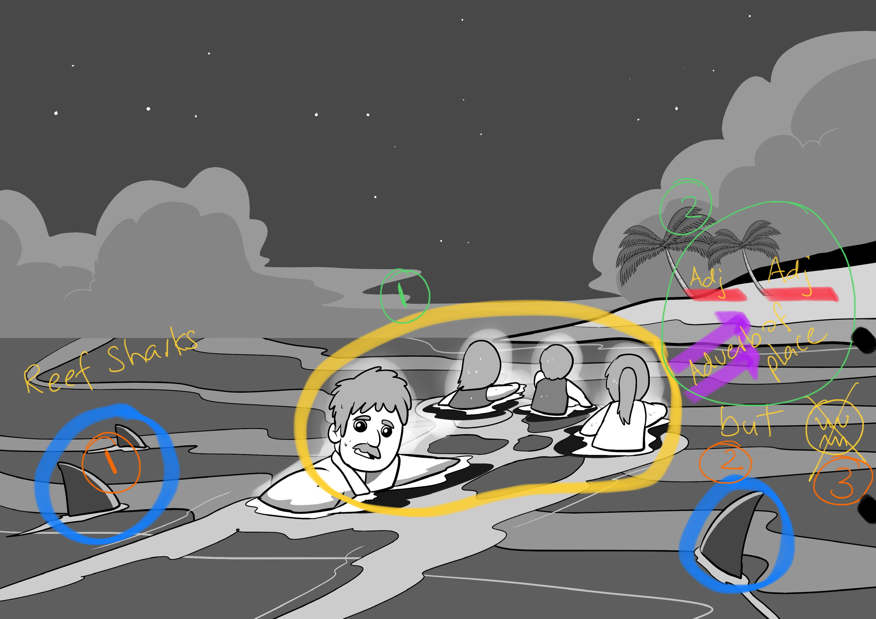

Slide 107
Frame 5

Slide 109
Student Workbooks

Slide 110
Verbs

Slide 111
Alliteration

Slide 112
What I Learned

